Slide 1
Art Gallery Problems

Slide 2
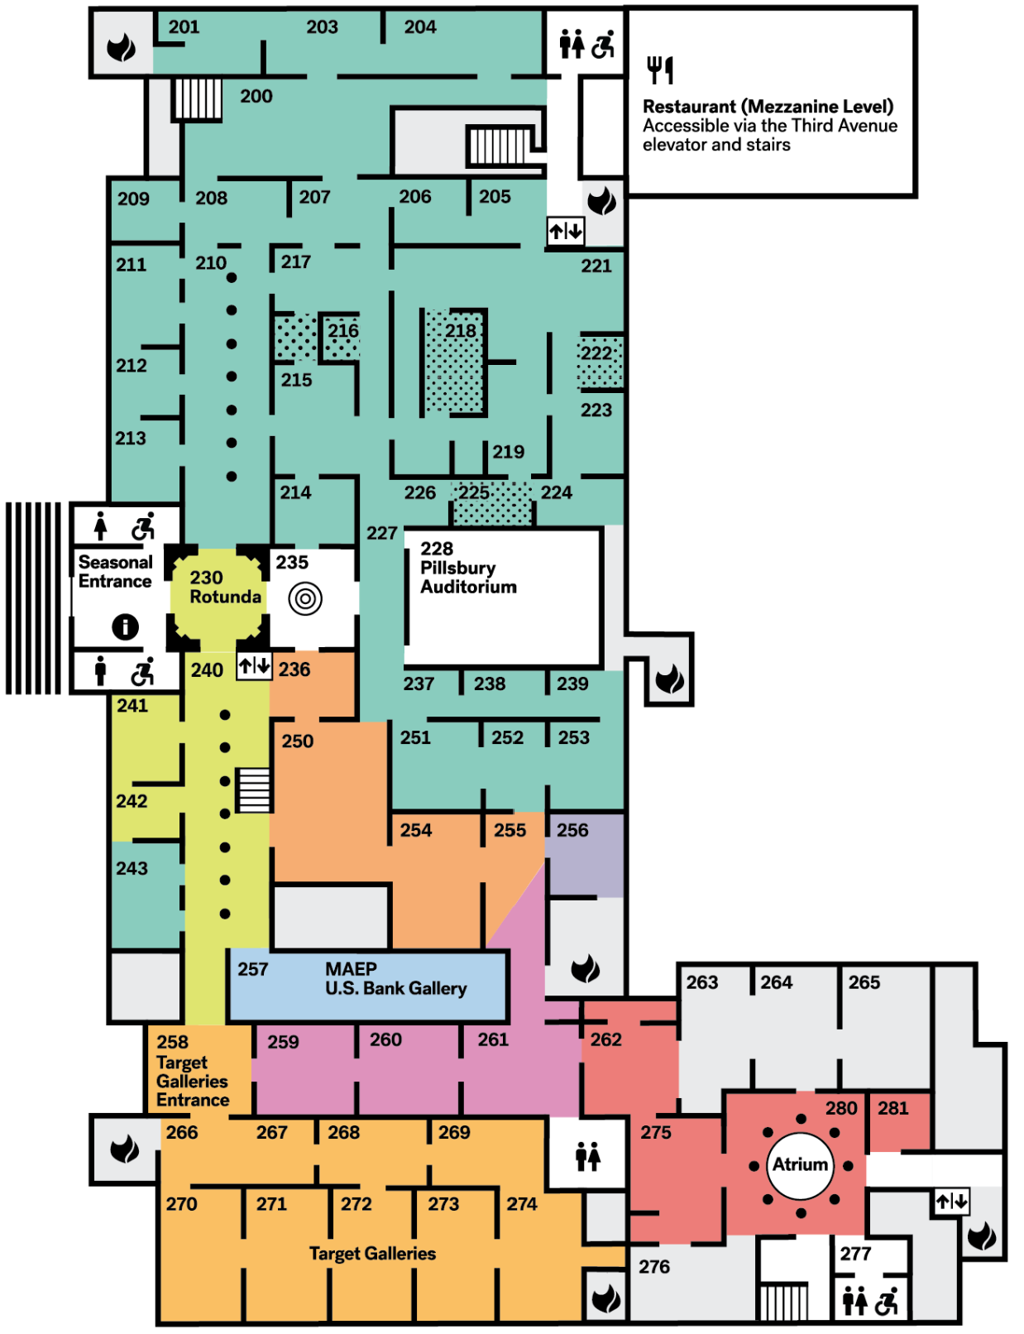
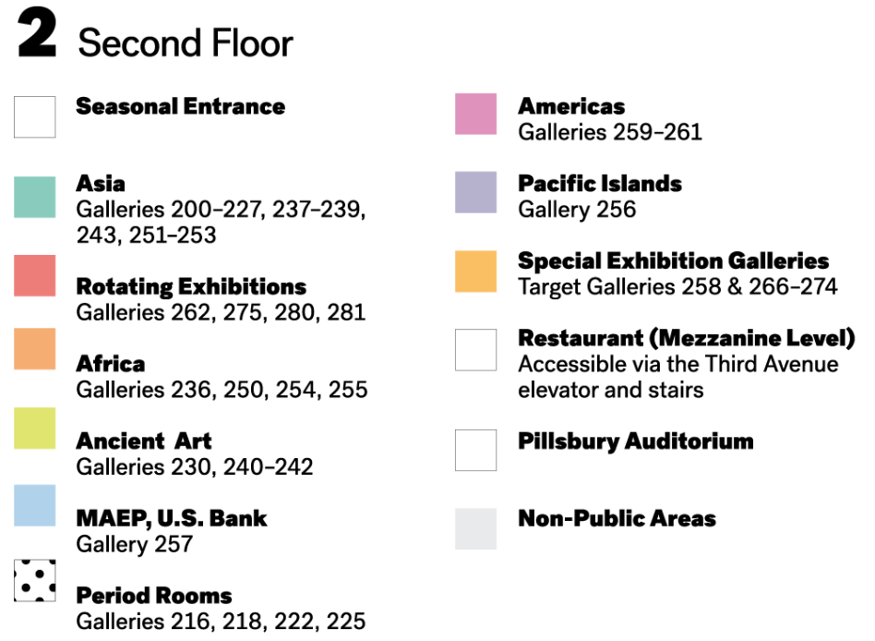
Minneapolis Institute of Art
https://new.artsmia.org/visit/gallery-map

Slide 3
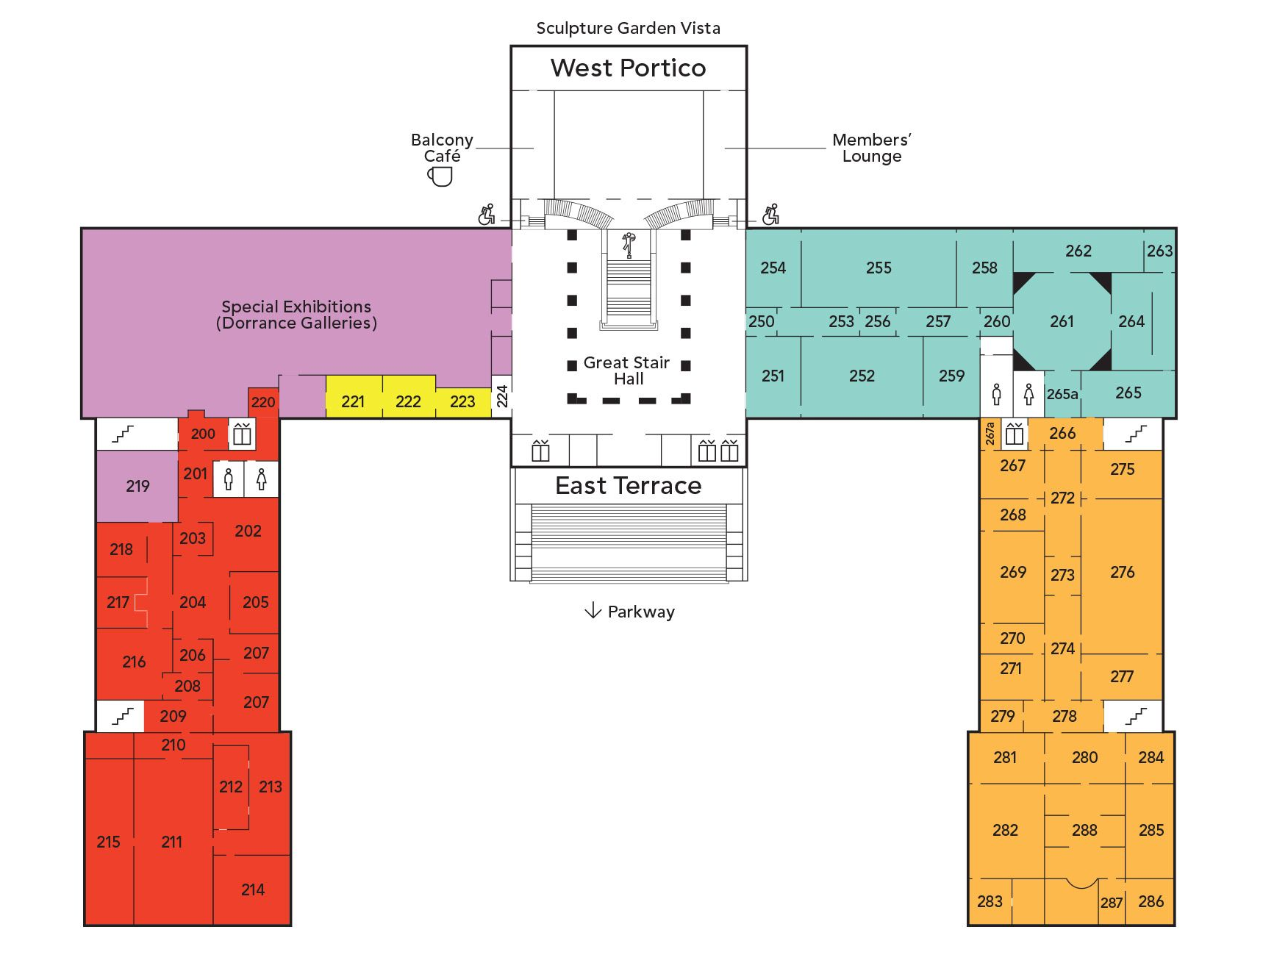
Philadelphia Museum of Art
https://philamuseum.org/visit/museum-map

Slide 4
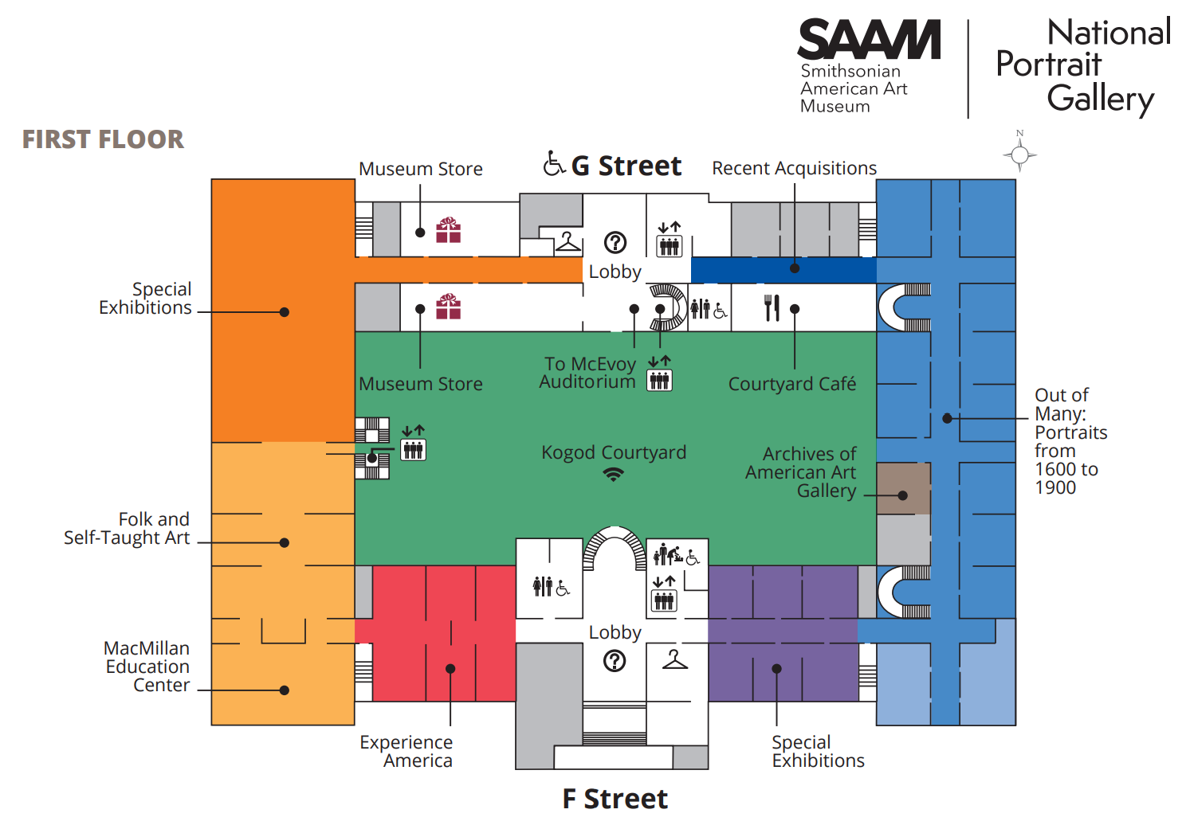
https://npg.si.edu/sites/default/files/2021map.pdf

